Slide 1

Welcome to the
Captain’s Meeting!
Big Pink Volleyball

Slide 2
THANK YOU!!!
38 TEAMS!!!

Slide 3
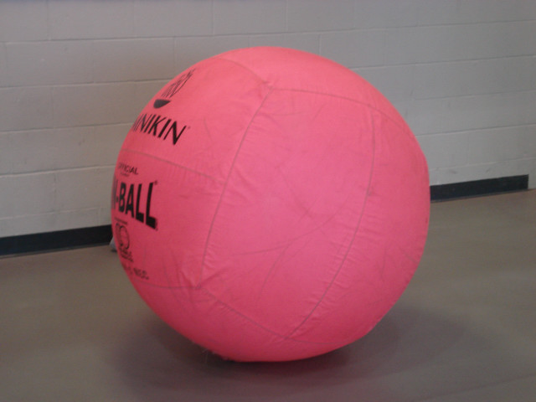
Getting into the Building
Participants need a valid UCO ID to enter.
For employee team members, you need will an University ID and sign a waiver.
After entering, head to the bottom floor to check-in for your game!

Slide 4
Checking-In
Find the check-in table
  Make sure you know your Team Name
  And how many members of your team are present
  We will let you know when and where you will play
If there is repeat team name, we will add the captain’s last name to the team name
Please arrive 10 minutes early to your game!

Slide 5
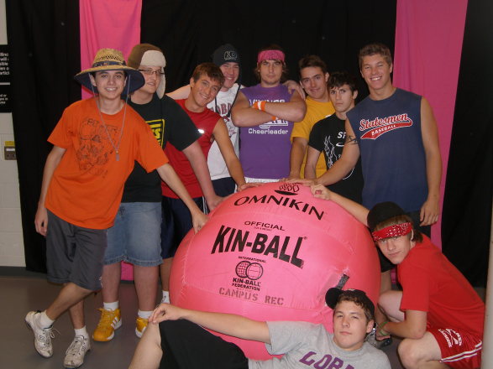
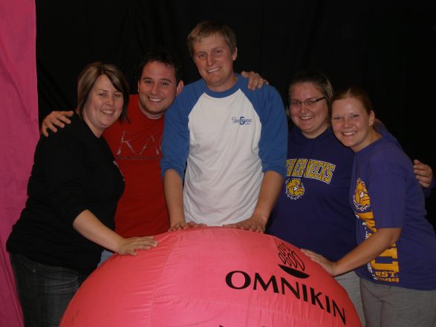
Checking-In (cont’d)
Once you have checked-in, please do not leave.
We will call your team name when it is your turn to play, so stick around
No jewelry should be on! (ie. Earrings and body piercings) – Please let your team know this beforehand.

Slide 6
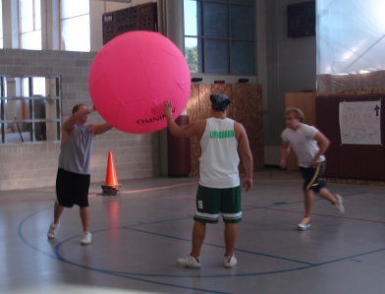
Tournament and Play Rules
Rock-paper-scissors will be used to determine first serving team
Serving the ball:
  The ball is served from the 10ft line on the court
  2 other members are allowed to help serve the ball
  Serves cannot be blocked by the opposing team

Slide 7
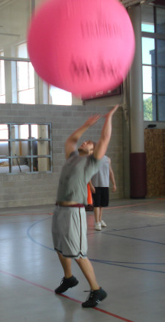
Tournament and Play Rules
A ball cannot be played off the wall or curtain
  Trapping the ball in the net is not allowed
Teams must rotate after server exchanges
  Rotation is clockwise

Slide 8
Tournament and Play Rules
Scoring: Rally scoring
  A point is scored every serve, regardless of which team serves
Maximum of three hits per side
The volleyball court is the boundary line
No heading or kicking the ball!
Athletic shoes must be worn, no bare feet or flip-flops

Slide 9
Tournament and Play Rules
Games last 15 minutes, the team with the
Most points wins at the end of 15 minutes. Must win by one point.
  In case of tie, play until next point is made
Single elimination tournament
At any time, there must be 4 players per team, with a maximum of 6 on the court
Lastly, don’t forget to HAVE FUN!

Slide 10
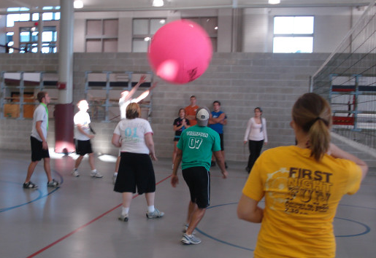
After the Game
The winning team captain must report the score of the game and who won, to the check-in table
  You will then be given your next game time
Once you are done playing,
  head on over to take
  your team photo!

Slide 11
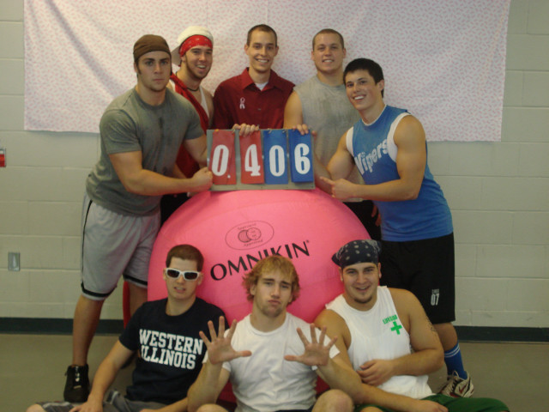
Team Photo
Every team will have their photo taken with one of
the big pink volleyballs after their first game!
Pictures will only be taken on the first two days of game play.
Please do not sit or lean on the balls!

Slide 12
Schedule Changes
If for some reason you cannot make your scheduled first game time, you are responsible for finding a team to switch with.
  We can help facilitate this after the meeting.
Please let us know as soon as possible about the switch so that we are up-to-date.
This can be done immediately following this meeting.

Slide 13
Shirts
T-shirts will be on sale the days of the event
Two kinds:
  Short sleeve pink - $10
  Short sleeve black - $10

Slide 14
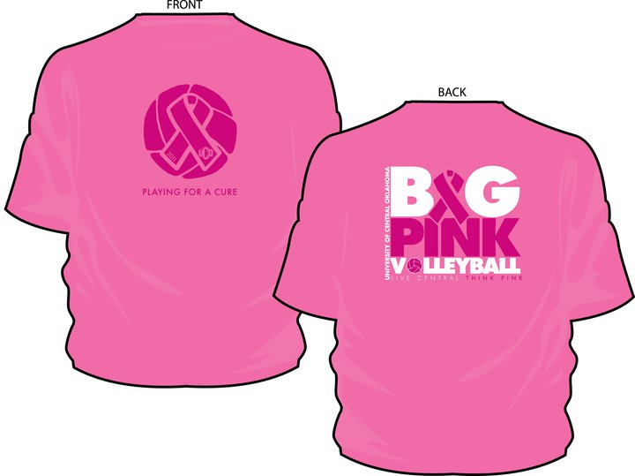

Slide 15


Slide 16
Big Pink Raffle
Tickets are $2 a piece
YOU COULD WIN:
  Mammogram courtesy of Breast Imaging of Oklahoma
  Quilt made by breast Cancer Survivor, Jo Wolken

Slide 17
What You Are Playing For…
Free Big Pink T-Shirts
Big Pink Volleyball Traveling Trophy and picture in CAE Display Case

Slide 18
Wall of Wishes
Please take the time to add your thoughts to this year’s Walls of Wishes located near the check in area.

Slide 19
Thank You!
Thank You for putting a team together!
We will be unveiling how much we raised at our Big Pink Check Presentation that will be taking place on Thursday March 3 at 4:30pm.

Slide 20
Have Fun!
One last thing…
Have Fun!

